Slide 1
History
By Artineer

Slide 2
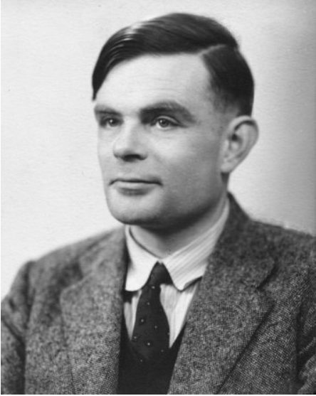
Alan Mathison Turing
Alan Mathison Turing (앨런 튜링)
1912.6.23 – 1954.6.7
영국 출생
컴퓨터 과학의 아버지

Slide 3
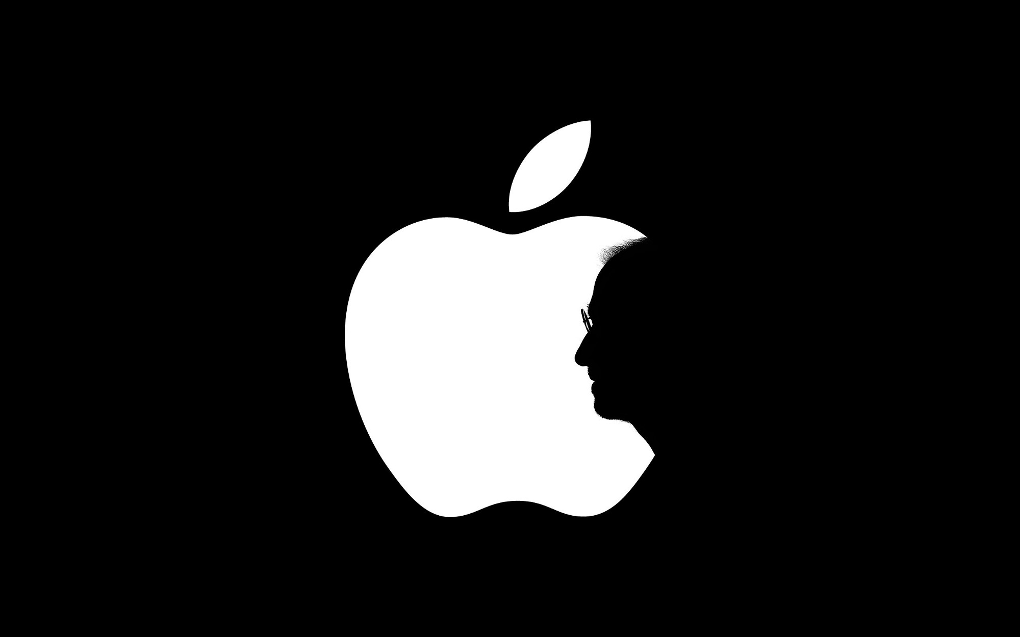
Alan Mathison Turing

Slide 4
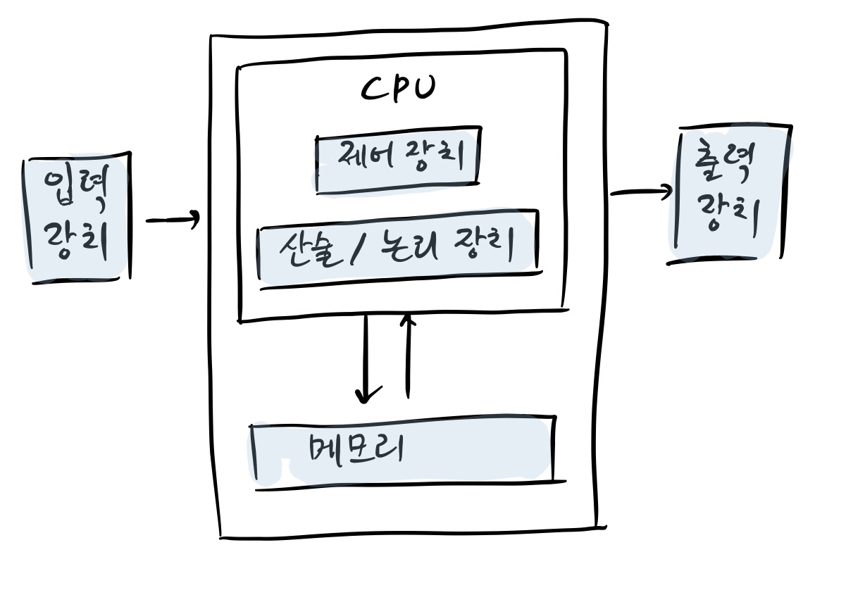
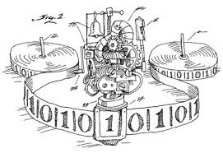
Alan Mathison Turing
Turing Machine
Von Neumann Structure

Slide 5
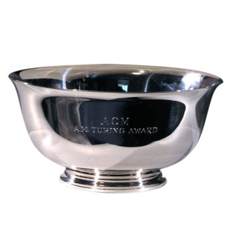
Alan Mathison Turing
Turing Award

Slide 6
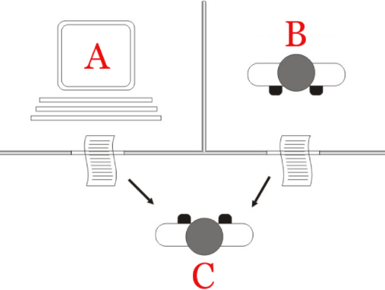
Alan Mathison Turing
Turing Test

Slide 7
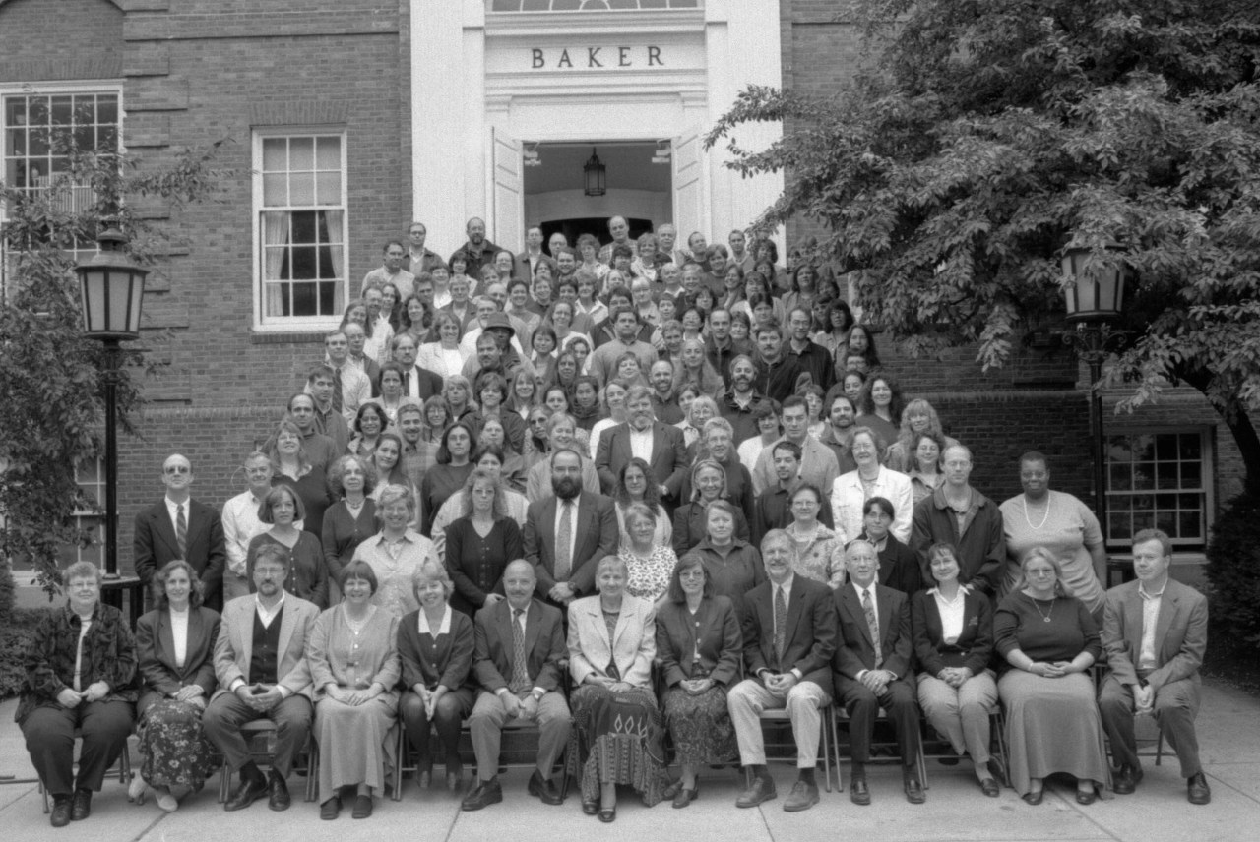
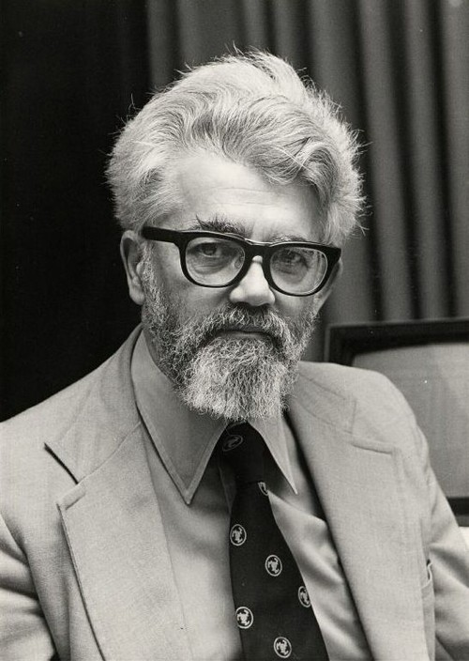
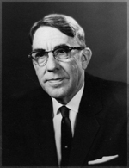
Dartmonth Conference
Dartmonth Conference
John McCarthy
Arthur Samuel

Slide 8
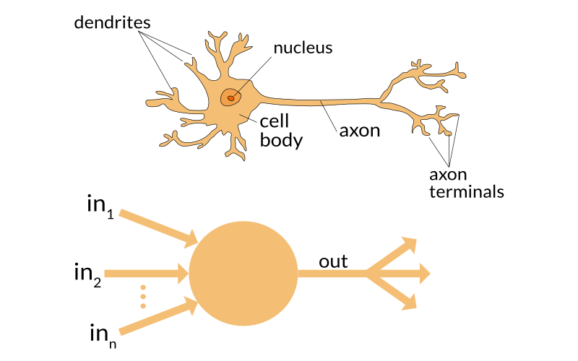
AI History
First Boom (1950s – 1960s)
Turing Machine
Perceptron

Slide 9
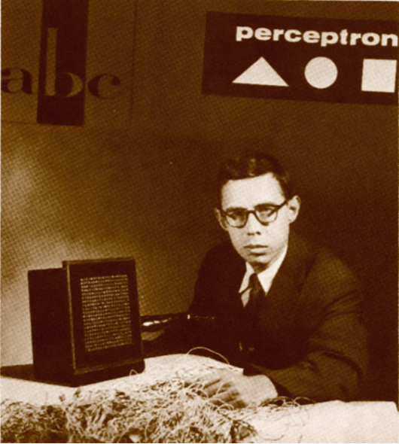
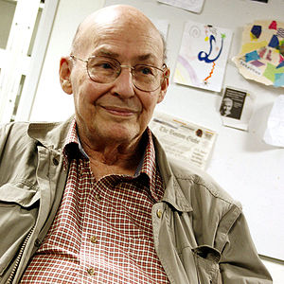
AI History
First Crisis (1960 – 1970s) : 1. XOR Problem
vs
Frank Rosenblatt
Marvin Lee Minsky

Slide 10
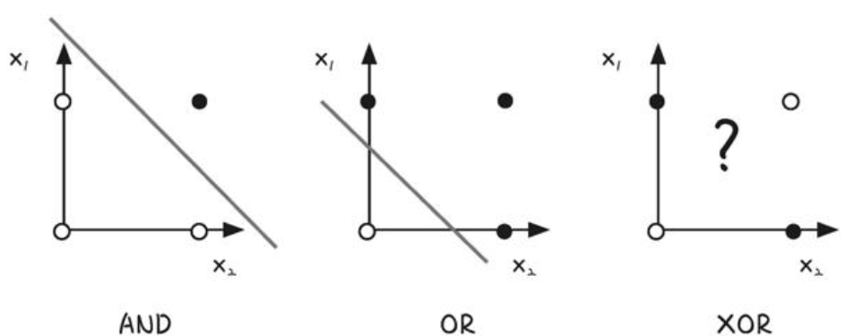
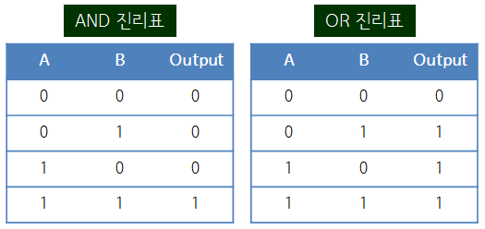
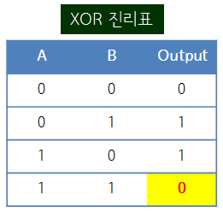
AI History
First Crisis (1960 – 1970s) : 1. XOR Problem

Slide 11
AI History
First Crisis (1960 – 1970s) : 2. Hardware limits

Slide 12
AI History
First Crisis (1960 – 1970s) : 3. too fundamental

Slide 13
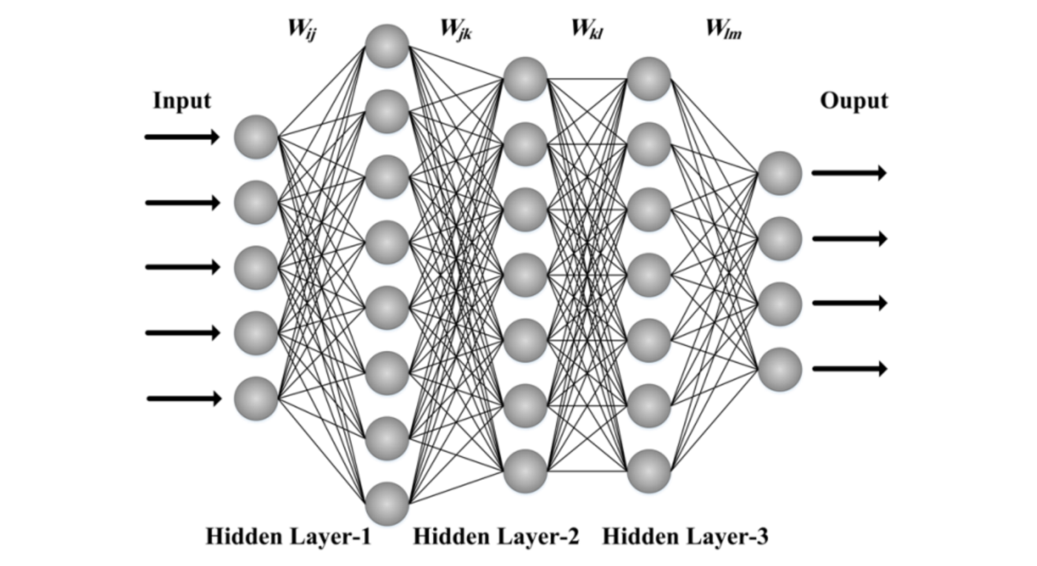
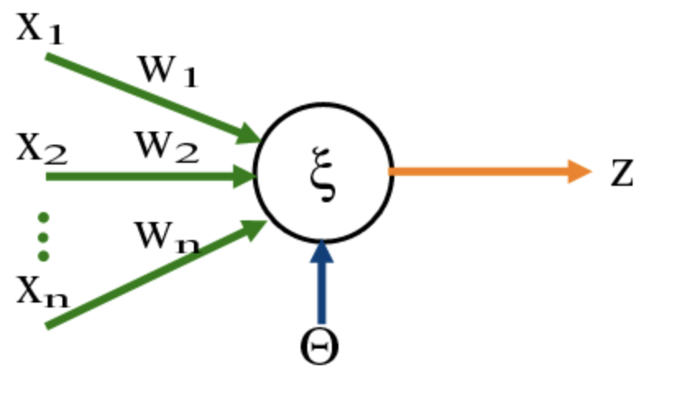
AI History
Second Boom (1980 – 1990s) : 1. Multi Layer Perceptron, Backpropagation

Slide 14
AI History
Second Boom (1980 – 1990s) : 2. Hardware limits
Approximately from 10 to 10⁵
약 1000배 증가

Slide 15
AI History
Second Boom (1980 – 1990s) : 3. Expert System
Input Knowledge
Expert System
Take a service
Expert
Client

Slide 16
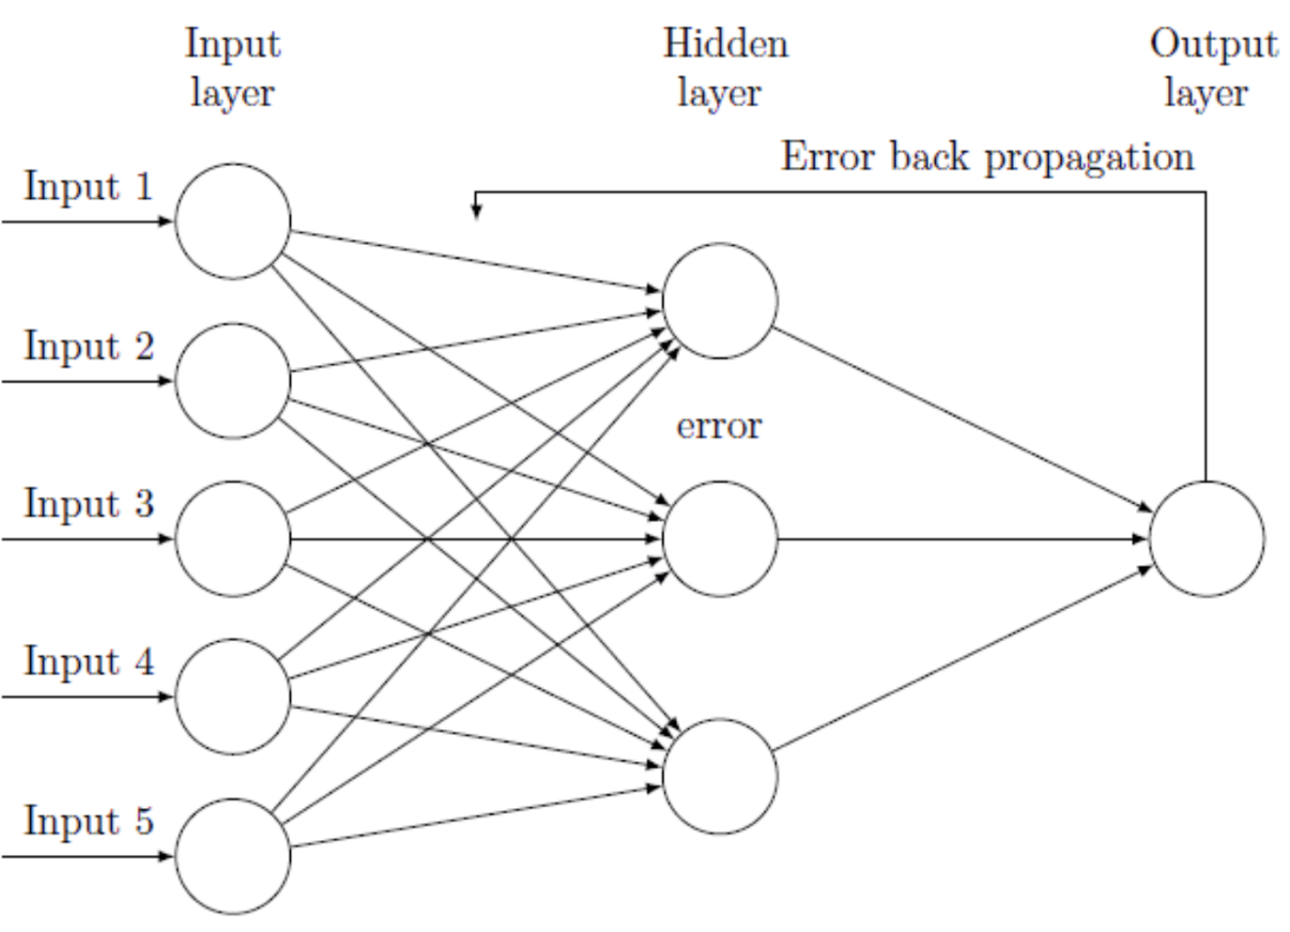
AI History
Second Crisis (1990 – 2000s) : 1. Error diminish

Slide 17
AI History
Second Crisis (1990 – 2000s) : 2. Hardware limits
Simple perceptron
possible
Multilayer perceptron
impossible

Slide 18
AI History
Second Boom (1980 – 1990s) : 3. Expert System
Convetional System
Learning System
vs
White Box
Black Box

Slide 19
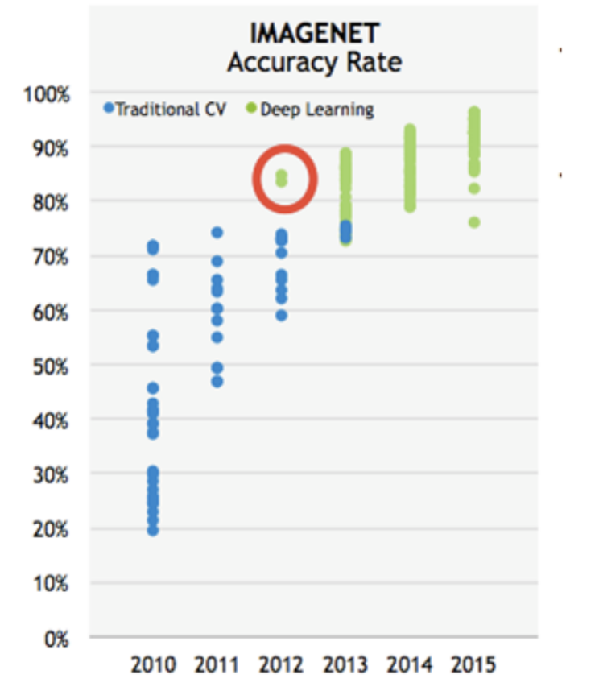
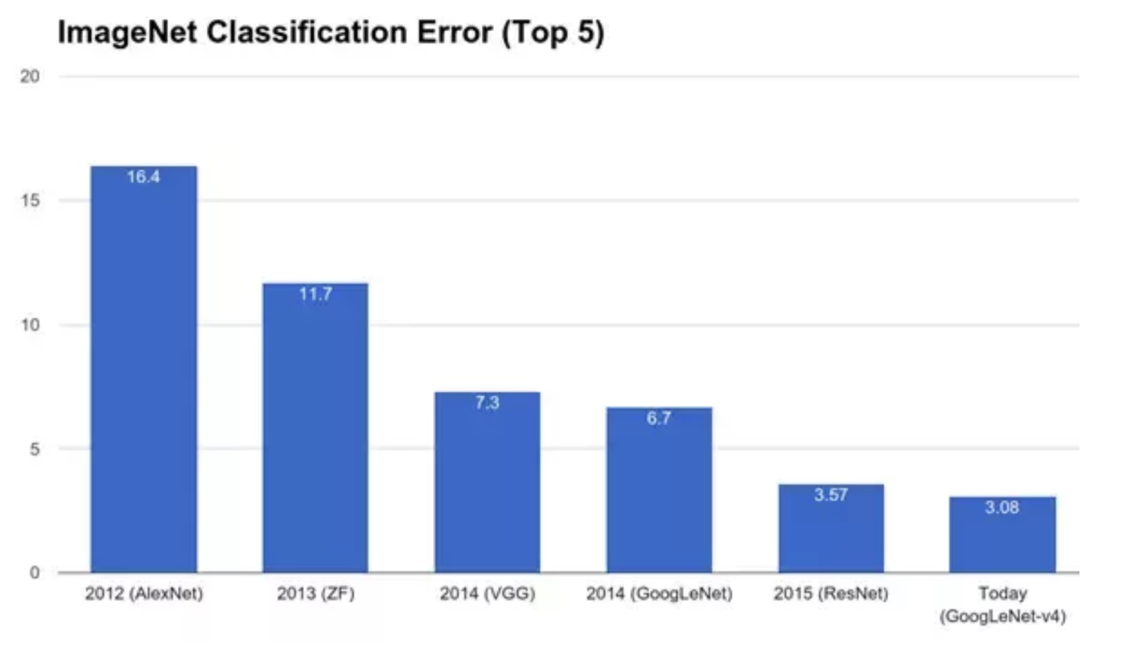
AI History
Third boom (2000 – 2010s) : IMAGENET CHALLENGE

Slide 20
AI History
Third boom (2000 – 2010s) : ALPHAGO

Slide 21
Category
By Artineer

Slide 22
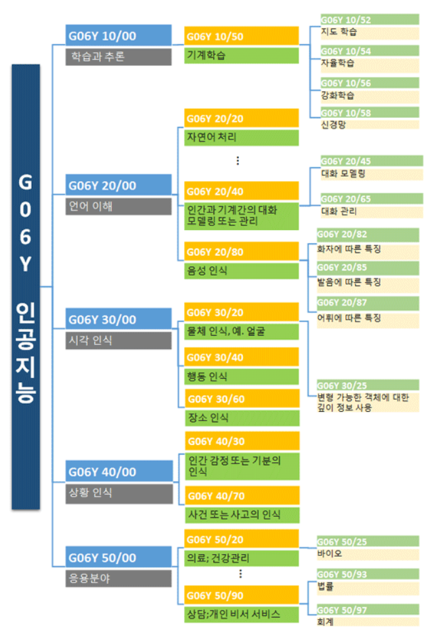
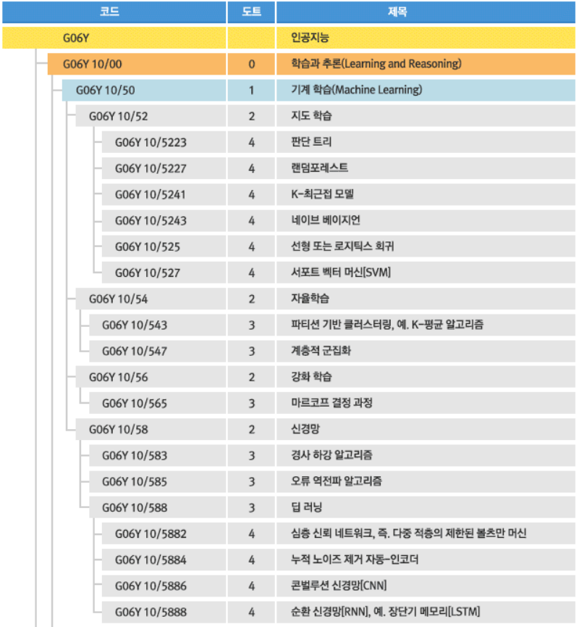
Category of AI

Slide 23
Category of AI
머신러닝
(Machine Learning)
비지도학습
(Unsupervised Learning)
강화학습
(Reinforcement Learning)
지도학습
(Supervised Learning)
군집
(Clustering)
MDP
분류
(Classification)
회귀
(Regression)
K -means
DBSCAN
…
SVM
K-NN
Decision
Tree
…
Linear
Regression
Logistic
Regression
Softmax
…

Slide 24
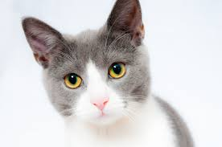
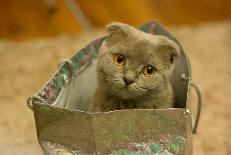
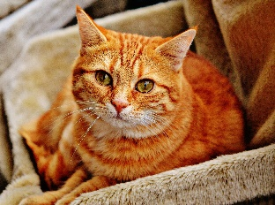
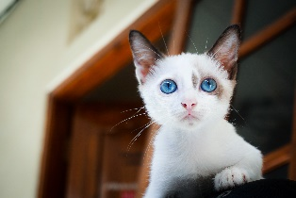
Category of AI
분류(Classification)

Slide 25
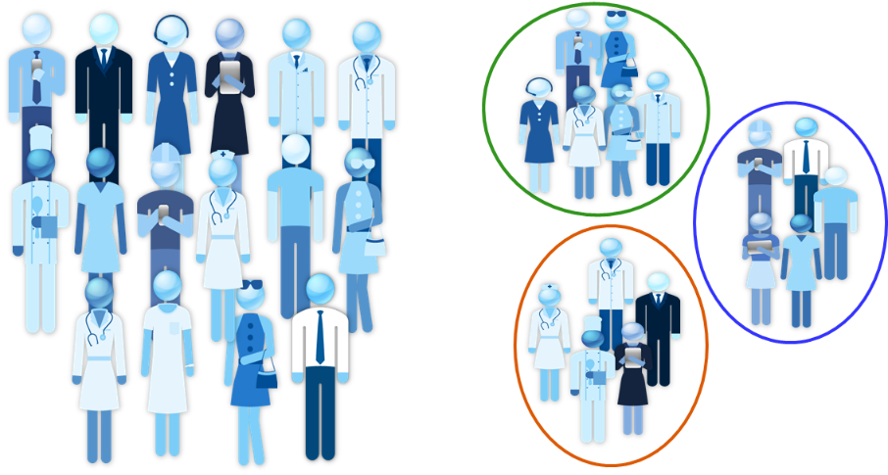
Category of AI
군집(Clustering)

Slide 26
Category of AI
강화학습(Reinforcement learning)
행동
보상
에이전트
환경

Slide 27
Category of AI
What is Regression ?

