Slide 1
Review
By Artineer

Slide 2
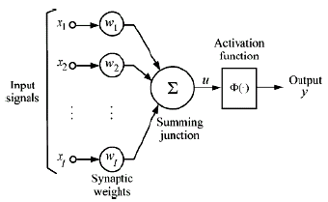
Artificial Neuron

Slide 3
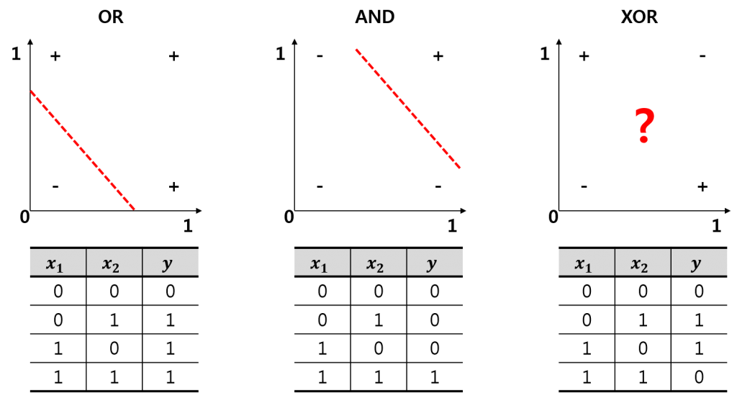
The problem of Artificial Neuron

Slide 4
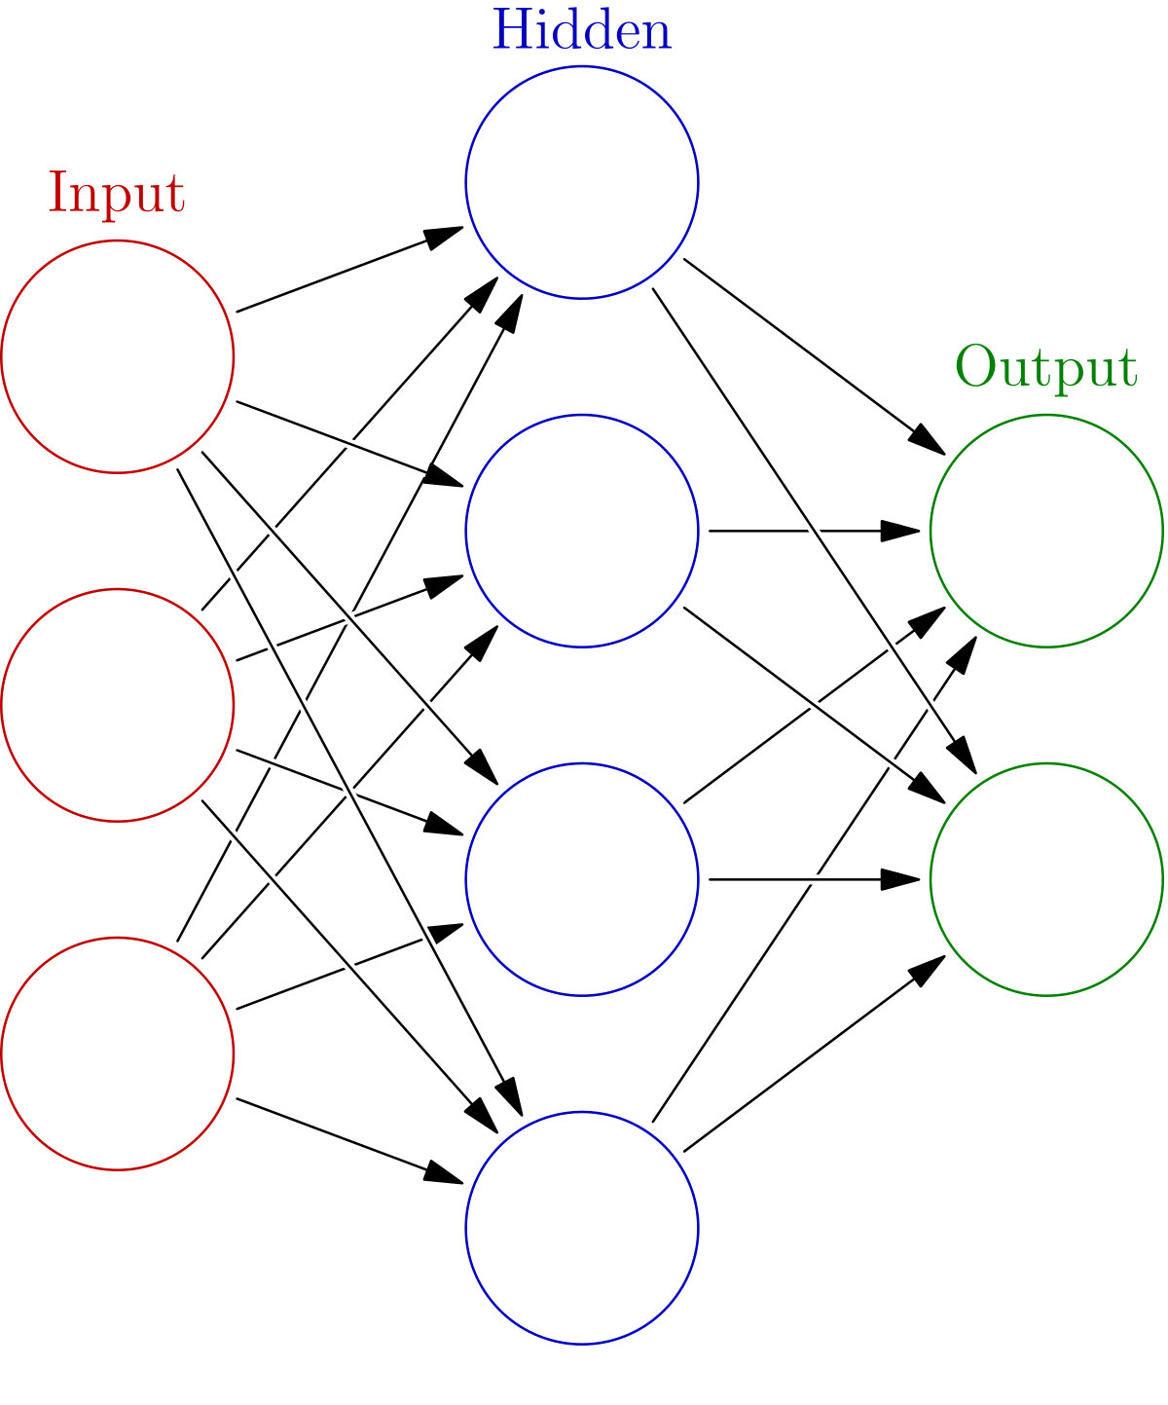
Neural Network

Slide 5
Hypothesis – forward propagation
a₁²
w₁₁¹
a₁¹
w₁₁²
a₂²
a₁³
$$a12 =sigmoid(a11 ∗w111+a21∗w211+a31 ∗w311)$$
a₂¹
a₃²
a₂³
$$a23 =sigmoid(a12 ∗w122+a22 ∗a222+a32 ∗w322+a42 ∗w422)$$
a₃¹
w₄₂²
w₃₄¹
a₄²

Slide 6
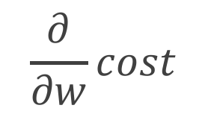
Cost Function
a₁²
w₁₁¹
a₁¹
w₁₁²
$$cost=−\frac{1}{m}\sum_{i=1}^{m}{\sum_{k=1}^{K}{(ylog\left(h\right)+\left(1−y\right)log⁡(1−h)}}$$
a₂²
a₁³
a₂¹
a₃²
a₂³
a₃¹
$$\frac{∂}{∂w}cost$$
w₄₂²
$$minimize$$
w₃₄¹
a₄²

Slide 7
Back Propagation
By Artineer

Slide 8
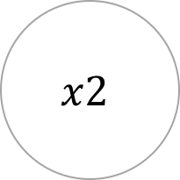
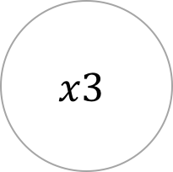
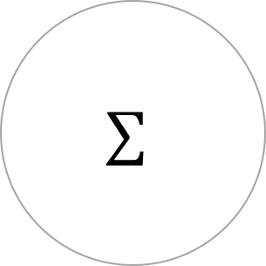
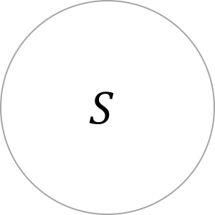
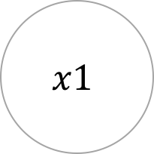
The meaning of weight
$$x1$$
$$w1$$
$$∑$$
$$S$$
$$x2$$
$$w2$$
$$h$$
$$x3$$
$$w3$$

Slide 9
The meaning of weight
$$x1$$
$$x2$$
$$h$$
$$x3$$

Slide 10
The meaning of weight
$$x1$$
$$x2$$
$$h$$
$$x3$$
$$\frac{∂}{∂w}cost$$
$$minimize ?$$

Slide 11
Back Propagation
Step1. forward propagation
a₁²
a₁¹
a₂²
$$h1$$
$$h1 =sigmoid(a12 ∗w112+a22 ∗a212+a32 ∗w312+a42 ∗w412)$$
a₂¹
a₃²
$$h2$$
$$h2 =sigmoid(a12 ∗w122+a22 ∗a222+a32 ∗w322+a42 ∗w422)$$
a₃¹
a₄²

Slide 12
Back Propagation
Step2. calculate the error of last node
a₁²
a₁¹
a₂²
$$δ13$$
$$δ13 =h1 −y1$$
a₂¹
a₃²
$$δ23$$
$$δ23 =h2 −y2$$
a₃¹
a₄²

Slide 13
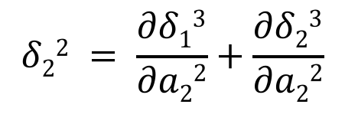
Back Propagation
Step2. error propagation
$$δ12 = \frac{∂δ13}{∂a12}+\frac{∂δ23}{∂a12}$$
$$δ12$$
$$δ22 = \frac{∂δ13}{∂a22}+\frac{∂δ23}{∂a22}$$
$$δ22$$
$$δ13$$
$$δ32 = \frac{∂δ13}{∂a32}+\frac{∂δ23}{∂a32}$$
$$δ32$$
$$δ23$$
$$δ42 = \frac{∂δ13}{∂a42}+\frac{∂δ23}{∂a42}$$
$$δ42$$

Slide 14
Back Propagation
Step3. calculate costs for each node
$$δ12$$
$$δ22$$
$$δ13$$
Accumulate until the number of training examples
$$δ32$$
$$δ23$$
Update Weights
$$δ42$$

