Slide 1
Logistic Regression
By Artineer

Slide 2
Review
Hypothesis
Cost Function
Gradient Descent

Slide 3
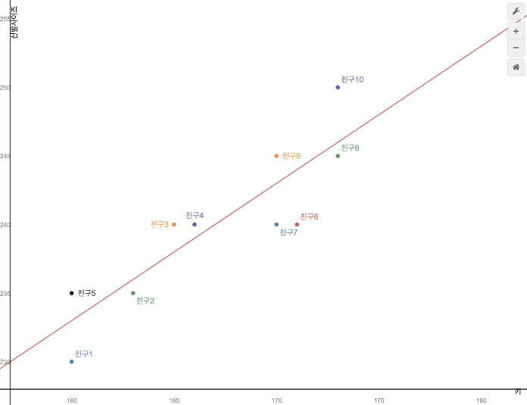
Review
Hypothesis
Simple
Linear Regression
Multiple Linear Regression
y = wx + b
y = w₁x₁ + w₂x₂ + b

Slide 4
Review
Hypothesis
Simple
Linear Regression
Multiple Linear Regression
h(x) = wx + b
h(x) = w₁x₁ + w₂x₂ + … + b

Slide 5
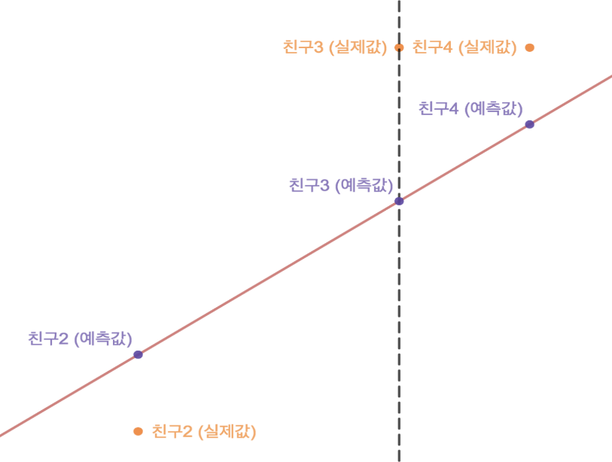
Review
Cost Function
Simple
Linear Regression
Multiple Linear Regression

Slide 6
Review
Cost Function
Simple
Linear Regression
Multiple Linear Regression
e(x) = $\frac{1}{2}\sum_{i=1}^{m}{\left(yi −(wxi+b)\right)2}$
e(x) = $\frac{1}{2}\sum_{i=1}^{m}{\left(yi −(XiW+ b)\right)2}$
= $\frac{1}{2}\sum_{i=1}^{m}{\left(yi −(w1x1i+w2x2i+ … + b)\right)2}$

Slide 7
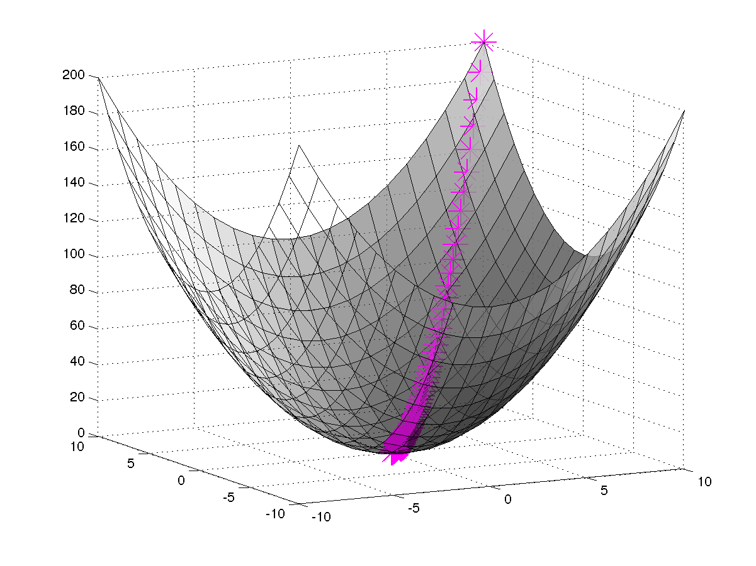
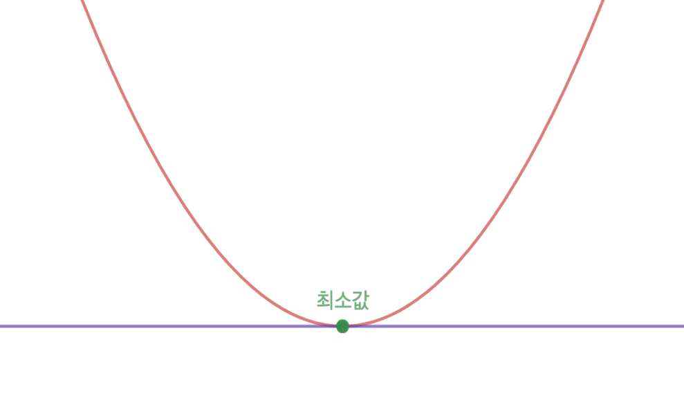
Review
Gradient Descent
Simple
Linear Regression
Multiple Linear Regression

Slide 8
Review
Gradient Descent
Simple
Linear Regression
Multiple Linear Regression
A_{1(n+1)} := a_{1(n)} + $α\frac{∂e}{∂a1}$
a_{n+1} := a_{n} + $α\frac{∂e}{∂a}$
A_{2(n+1)} := a_{2(n)} + $α\frac{∂e}{∂a2}$
b_{n+1} := b_{n} + $α\frac{∂e}{∂b}$
…
b_{n+1} := b_{n} + $α\frac{∂e}{∂b}$

Slide 9
Concept
Regression vs Classification
X1
X2
Regression Model
Y
…

Slide 10
Concept
Regression vs Classification
X1
X2
Regression Model
Y
…
Y = wx + b

Slide 11
Concept
Regression vs Classification
Y = wx + b
Continuous value
y = wx + b
How to express discrete value

Slide 12
Concept
Classification Example
What is your gender?
vs

Slide 13
Concept
Classification example
Choose the dog from these pictures.
vs

Slide 14
Concept
Classification example
h(x) = wx + b
This hypothesis is not properly about choosing discrete values.

Slide 15
Concept
New Hypothesis

Slide 16
Concept
New Hypothesis

Slide 17
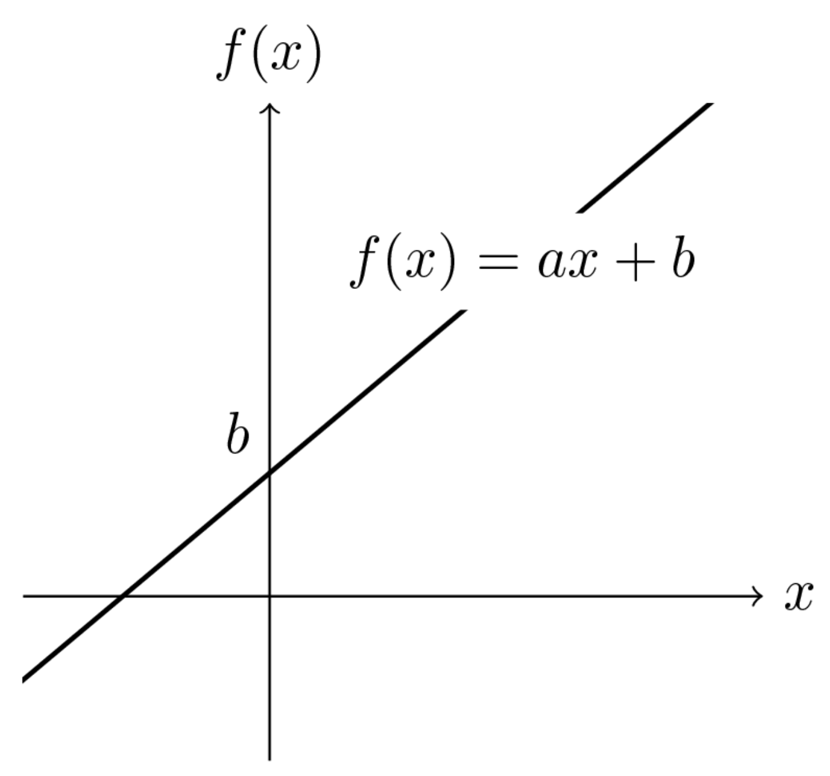
Concept
New Hypothesis
+
f(x) = ax + b

Slide 18
Concept
New Hypothesis
X1
X2
Linear Function
Sigmoid Function
Y
…

Slide 19
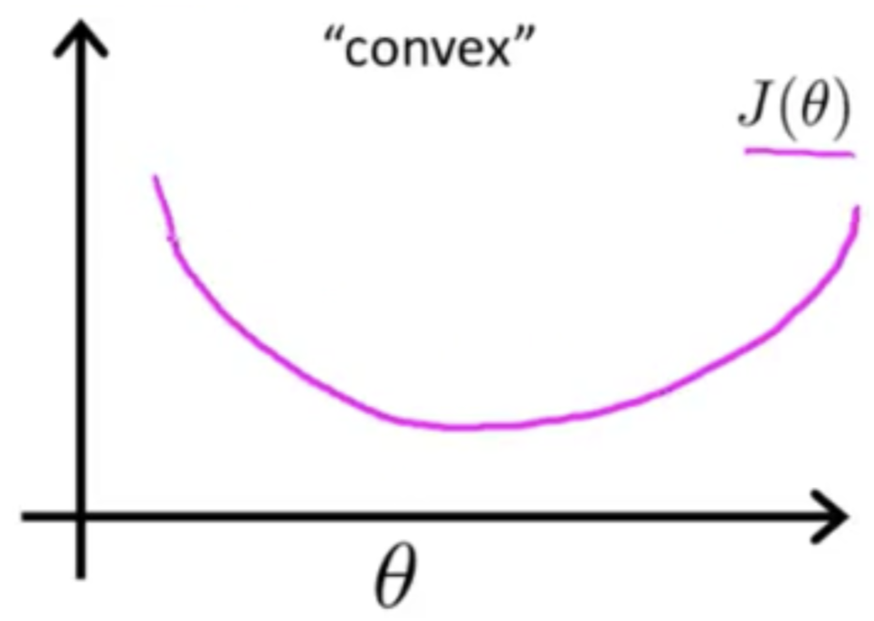
Concept
Convex vs Non-Convex
e(x) = $\frac{1}{2}\sum_{i=1}^{m}{\left(yi −f\left(xi\right)\right)2}$
f(x) = ax + b

Slide 20
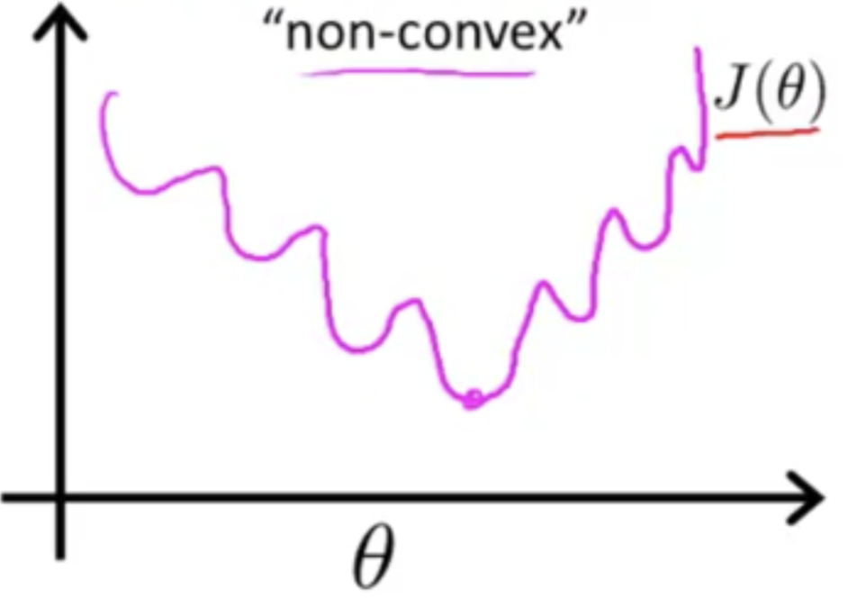
Concept
Mean Square error vs Cross Entropy
e(x) = $\frac{1}{2}\sum_{i=1}^{m}{\left(yi −f\left(xi\right)\right)2}$

Slide 21
Concept
Mean Square error vs Cross Entropy
Non Convex Function can not apply the gradient descent Model

Slide 22
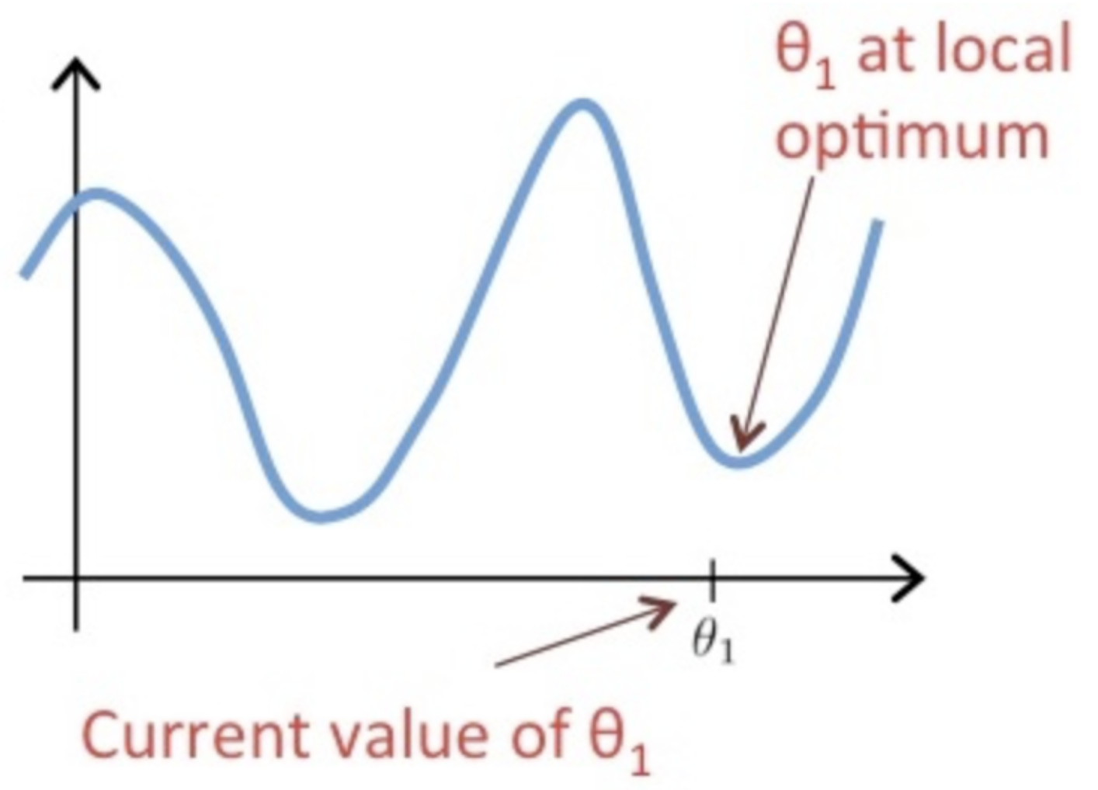
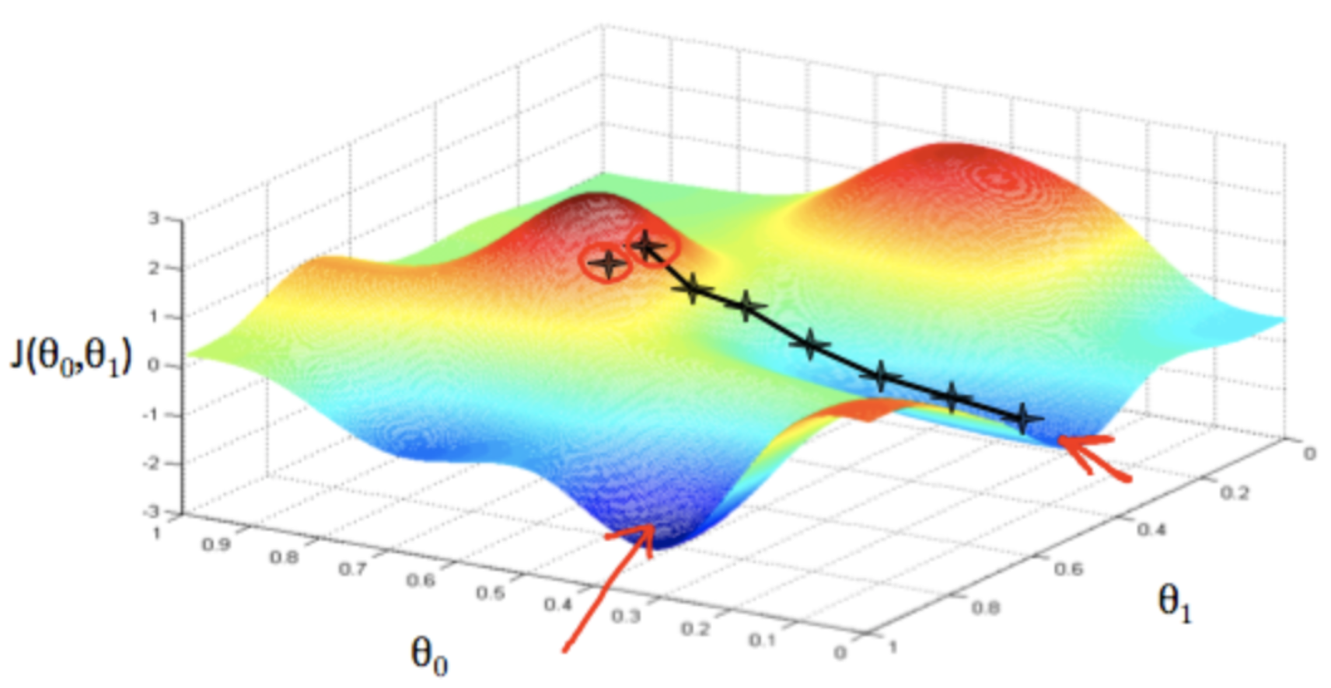
Concept
Local optimum vs Global optimum
Cross Entropy

Slide 23
Concept
New Cost Function – Cross Entropy Loss
e(x) =$\left\{\begin{aligned}−\log\left(H\left(x\right)\right) :y=1 \\ −\log\left(1 −H\left(x\right)\right).:y=0 \end{aligned}\right.$

Slide 24
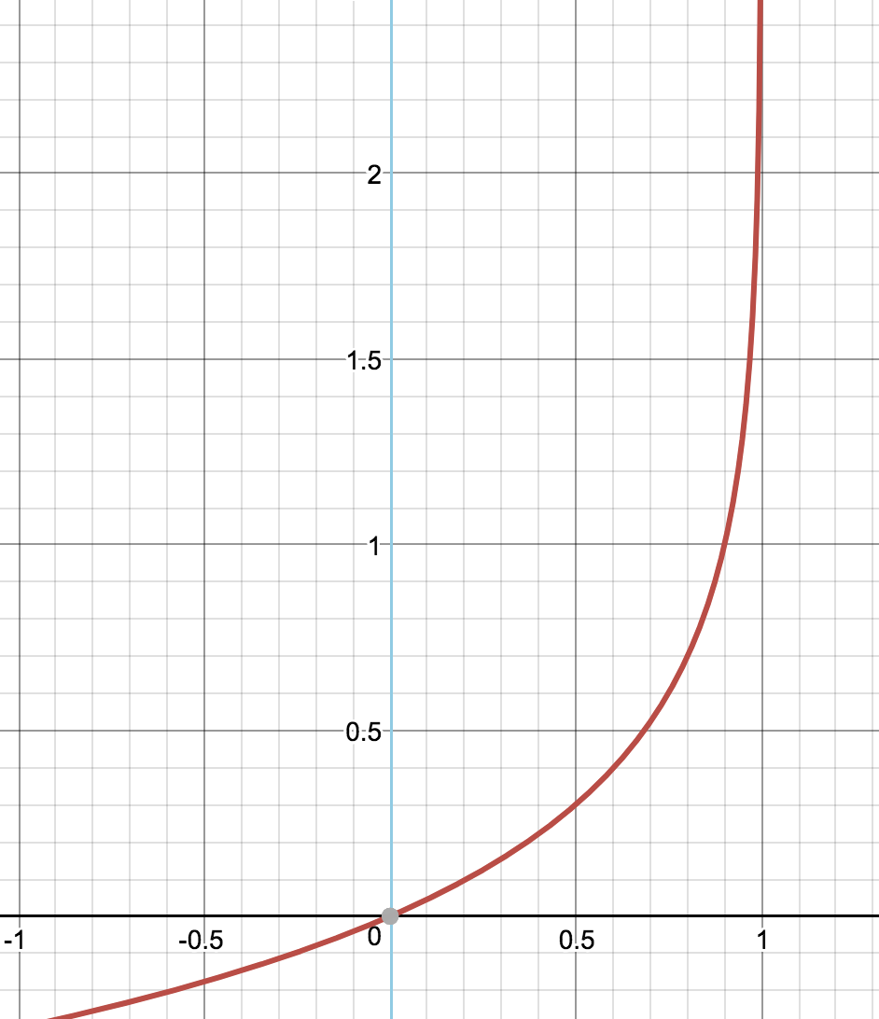
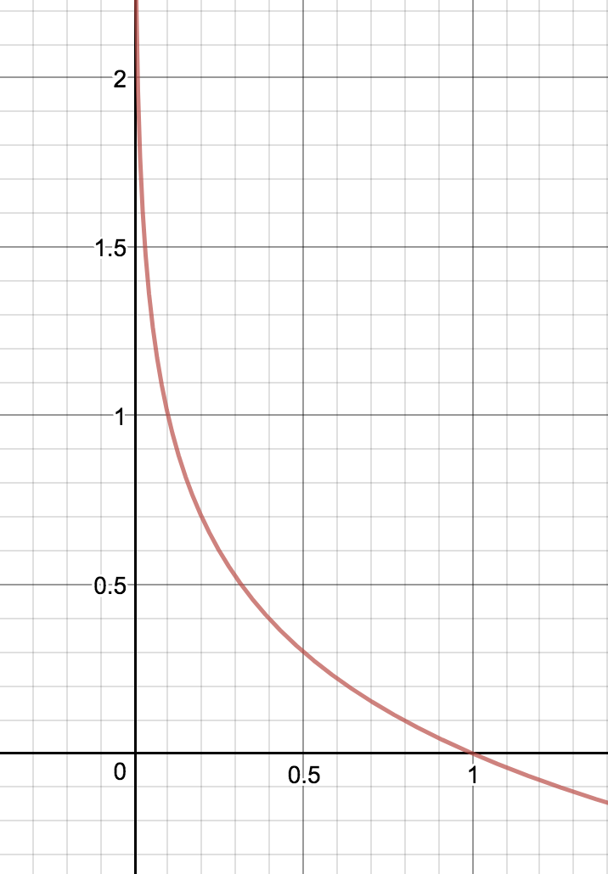
Concept
New Cost Function – Cross Entropy Loss
y = -log(1 - x)
y = -log(x)

Slide 25
Concept
New Cost Function – Cross Entropy Loss
e(x) =$\left\{\begin{aligned}−\log\left(H\left(x\right)\right) :y=1 \\ −\log\left(1 −H\left(x\right)\right).:y=0 \end{aligned}\right.$
e(x) = ylog(H(x)) – (1 - y)log(1 - H(x))

